Slide 1

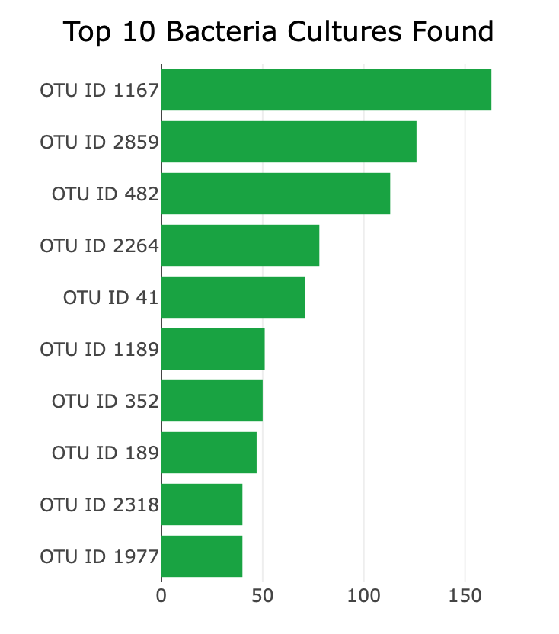
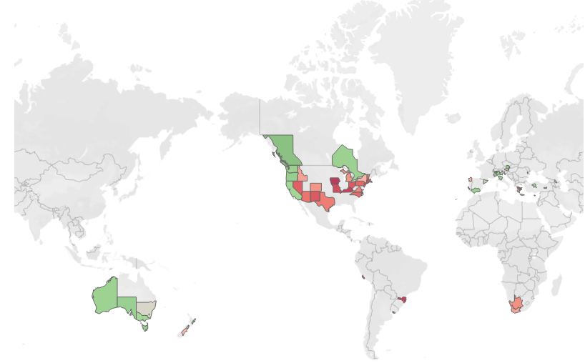
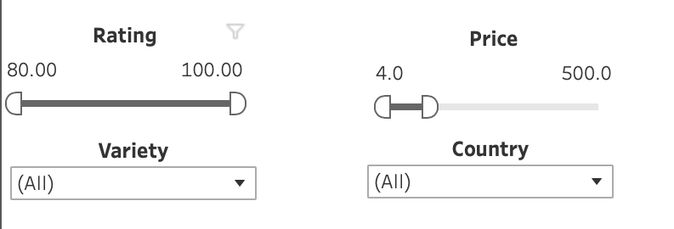
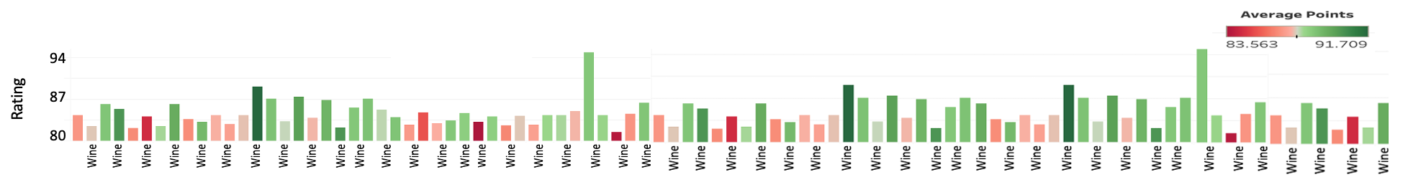
grape choice
Wine Selector Dashboard
Use the interactive Wine Selection Parameters below to find you next fav!
Wine Selection Parameters
Top 10 Rated Wines
Wine Ratings by Country
Wine 1
Wine 2
Wine 3
Wine 4
Wine 5
Wine 6
Wine 7
Wine 8
Wine 9
Wine 10
70
80
90
100
All Wine Choices
Copyright Data Viz-Wizards 2023

